Slide 1

Real Time Stock Prediction Using RNN
INT 635 Internship 4
Team Members
1. Sree lakshmi A - E7321005
2. Prem Kumar K S - E7321013
3. Pavithran V - E7321014
Project Guide
Dr. V .Vanitha

Slide 2



Real Time Stock Prediction Using RNN

Slide 3


Introduction
Stock markets play a crucial role in the global economy, and investors are constantly seeking ways to make informed decisions to maximize their returns. However, predicting stock prices accurately is a challenging task due to the complex and dynamic nature of financial markets.
In recent years, advancements in technology and the availability of vast amounts of financial data have paved the way for the development of sophisticated prediction models. These models utilize various techniques and algorithms to analyze historical market data and identify patterns that can help forecast future stock prices.
we will explore different approaches and techniques used in stock prediction. We will delve into the concept of machine learning and how it can be applied to financial data. Specifically, we will focus on the utilization of recurrent neural networks (RNNs) with long short-term memory (LSTM) units, which are well-suited for modeling sequential data such as stock prices.

Slide 4




Problem statement/Objectives
How Deep Learning can help stock prediction?
The objective is to accurately forecast stock prices in real-time, providing investors and traders with timely and reliable information for making informed decisions in the dynamic and volatile financial markets.
To address these challenges, the proposed solution leverages the power of RNN-LSTM, a deep learning architecture known for its ability to model sequential data effectively. By analyzing historical stock price data, incorporating relevant features, and learning from patterns over time, the RNN-LSTM model aims to capture complex temporal dependencies and generate
accurate predictions in real-time.

Slide 5

Review of Literature
1 - "Stock market prediction using support vector machines" by Hsieh et al. (2011)
This research investigates the application of Support Vector Machines (SVM) for stock market prediction.
The authors use historical stock price data and relevant technical indicators as input features to train the SVM model.
They demonstrate the effectiveness of SVM in capturing complex nonlinear relationships and achieving accurate predictions.
2 - "Real-time stock market forecasting using machine learning algorithms" by Khedr et al. (2018)
This study compares the performance of various machine learning algorithms, including ARIMA, SVM, and Random Forest, for real-time stock market forecasting.
The authors evaluate the models based on accuracy, precision, and recall, highlighting the strengths and limitations of each algorithm.
They conclude that the Random Forest algorithm outperforms other models in terms of prediction accuracy.

Slide 6
3 - "Real-time forecasting of stock market using wavelet analysis and extreme learning machine" by Tsai et al. (2015)
The authors propose a hybrid model combining wavelet analysis and Extreme Learning Machine (ELM) for real-time stock market forecasting.
They leverage wavelet decomposition to extract multi-scale features from stock price data and use ELM as the prediction model.
The hybrid model achieves improved accuracy compared to individual models and demonstrates the effectiveness of wavelet analysis in capturing market dynamics.
These studies highlight the diverse range of time series models, such as ARIMA, SVM, and hybrid models, applied to real-time stock prediction

Slide 7

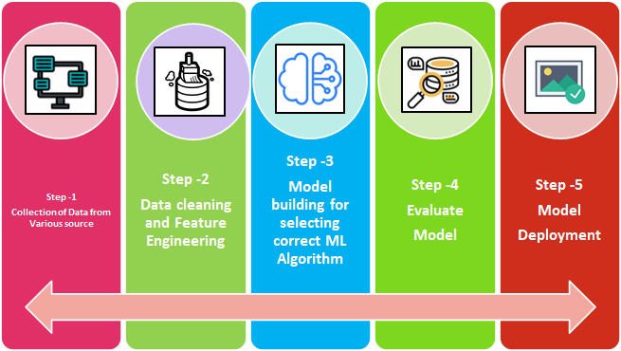
Work Flow
1
Data preparation
4
Train the model
Collection of dataset for the model
model learns to recognize patterns in the data
2
Data pre-processing
Hyperparameter tuning
5
Preparing the image data
tain ,test,val
cropping
augmenting
such as the learning rate or number of layers, to improve its performance
3
Model
Deploy the model
6
deep learning architecture
RNN - LSTM
model deploying it for the Real-time access in a website (Streamlit)
Notes:
Data collection: Collecting a large dataset of labeled images that will be used for training the deep learning model.
Data pre-processing: Preparing the image data for use in training the model, which may include resizing, cropping, normalizing, or augmenting the images.
Model selection: Choosing the appropriate deep learning architecture, such as convolutional neural networks (CNNs), that is suitable for the task at hand.
Training the model: Training the deep learning model using the prepared image data, which involves forward propagation and backpropagation of errors to adjust the model's weights.
Model evaluation: Evaluating the performance of the model on a validation dataset to assess its accuracy and other metrics.
Hyperparameter tuning: Tweaking the model's hyperparameters, such as the learning rate or number of layers, to improve its performance.
Test the model: Using a test dataset to validate the performance of the model on unseen data.
Deploy the model: Deploying the trained model for use in real-world applications, which may involve integrating it into an existing software system or creating an API for other applications to use.

Slide 8


Data preparation
Yahoo Finance is a comprehensive platform that offers a wealth of financial information, tools, and resources for investors and traders. Its real-time and historical data, coupled with news and analysis, make it a valuable resource for conducting market research, analyzing stocks, and making informed investment decisions.
Download and extract the dataset files from yfinace
real time data.
Perform data cleaning to remove any corrupted or invalid data.
Utilize the Yahoo Finance API to retrieve historical stock data in real-time.
the stock symbol/ticker, start date, and end date for data retrieval.
Retrieve relevant features such as stock prices (open, high, low, close), volume, and any additional indicators required for analysis.

Slide 9
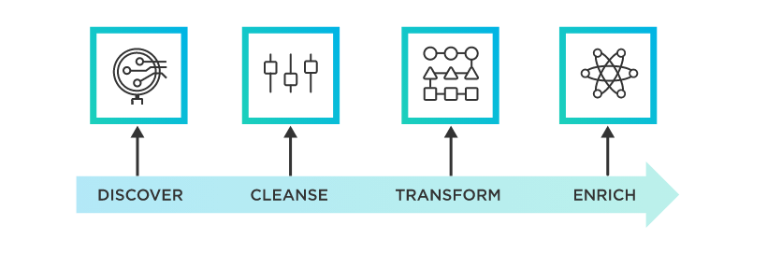
Data Cleaning:
Handle missing values: Check for any missing or null values in the dataset and apply appropriate techniques to handle them, such as interpolation or dropping the missing values.
Check for outliers: Identify and handle any outliers that may affect the analysis or model performance.
Feature Selection:
Select the relevant features that are likely to have an impact on stock price prediction.
Consider features such as historical prices, trading volume, technical indicators (e.g., moving averages, relative strength index), and any other relevant financial indicators.
Data Transformation:
Normalize or scale the features to ensure they are on a similar scale, as different features may have different ranges.
Common techniques include min-max scaling or standardization to ensure the data is comparable and to avoid any dominance of a particular feature during model training.

Slide 10
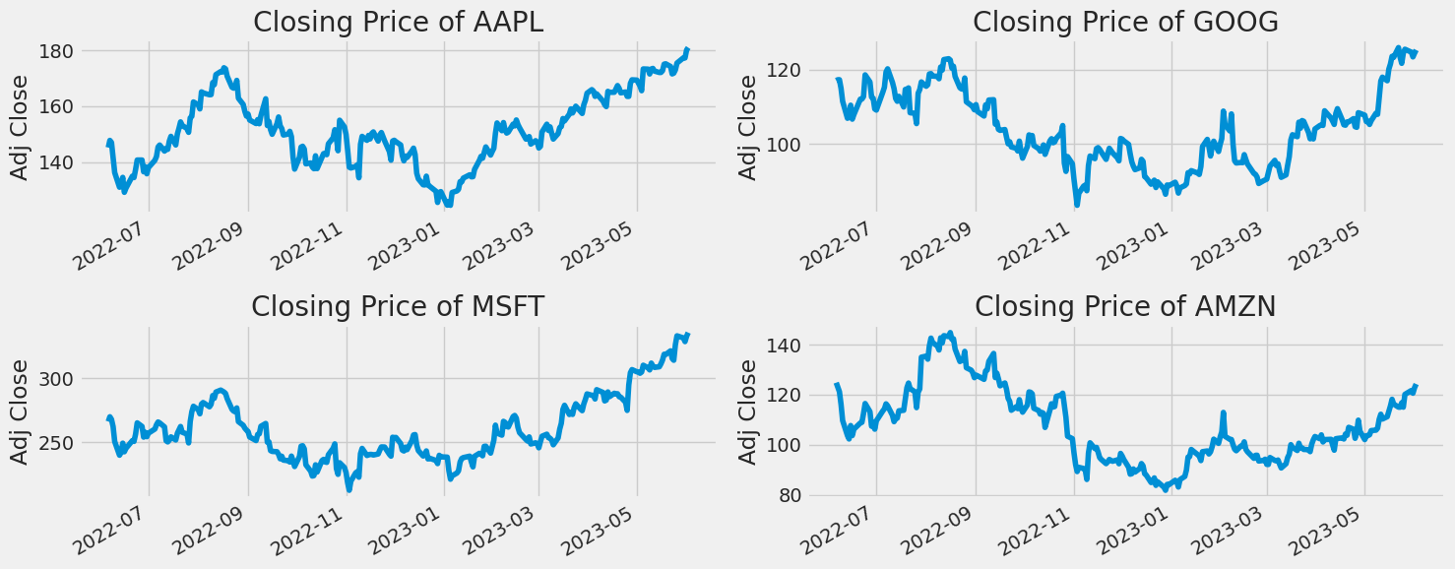
closing price of the Stocks plot

Slide 11
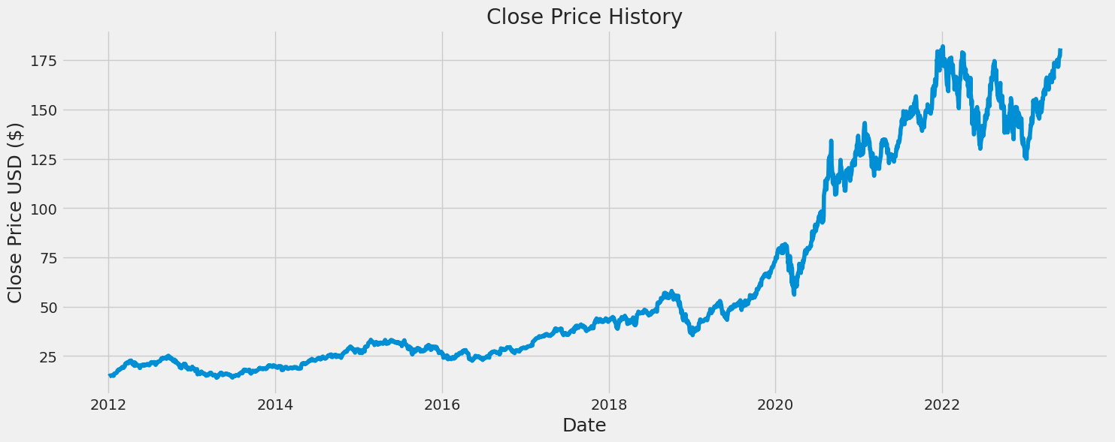
Currently creating a rnn model for Apple stock
closing price of the Apple

Slide 12

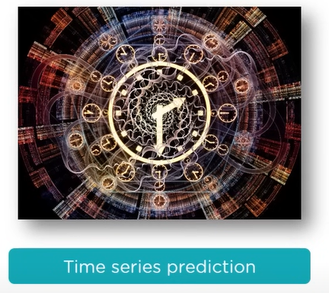
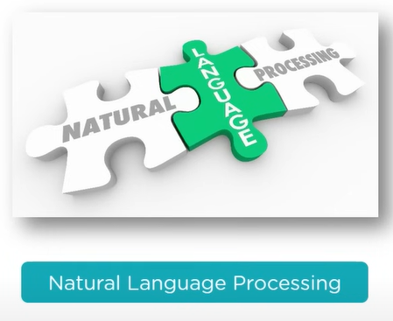
Applications of RNN
RNN is used to caption an image by analyzing the activities present in it
Any time series problem like predicting the prices of stocks in a particular month can be solved using RNN
Text mining and Sentiment analysis can be carried out using RNN for Natural Language Processing

Slide 13

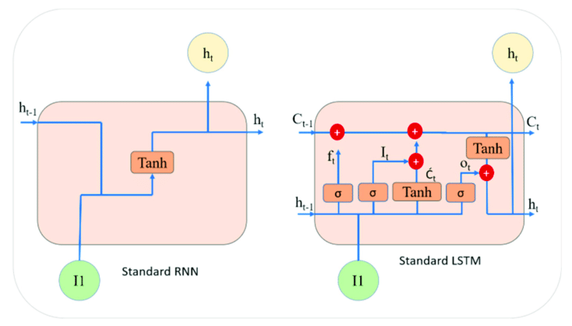
RNN- LSTM model
Neural Networks: Imagine a neural network as a computational model inspired by the human brain. It consists of interconnected nodes called "neurons" that process and transmit information.
Feedforward vs. Recurrent Networks: In a regular feedforward neural network, information flows in one direction, from the input to the output. However, RNNs have a feedback loop, allowing information to circulate within the network, making them suitable for sequential data analysis.
Long Short-Term Memory (LSTM): LSTMs are a specific type
of RNN that addresses the limitation of regular RNNs in
retaining and utilizing long-term information. LSTMs have
memory cells that can store and access information for longer
durations, making them well-suited for analyzing sequences
with long-term dependencies.

Slide 14
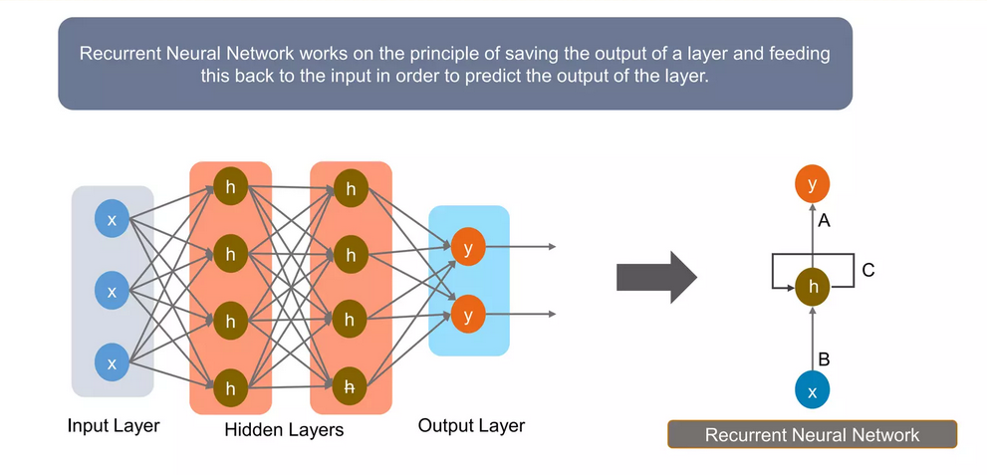
RNN layer

Slide 15
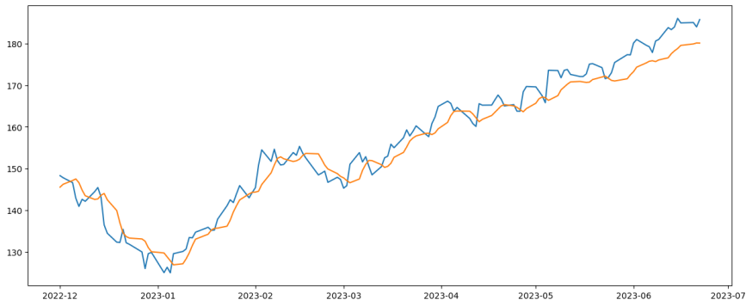
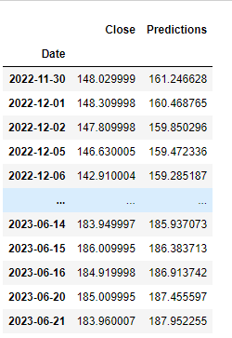

Prediction plot

Slide 16
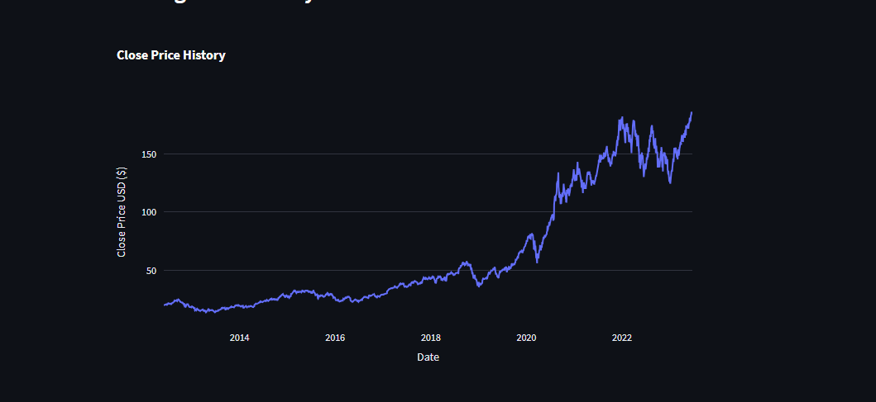
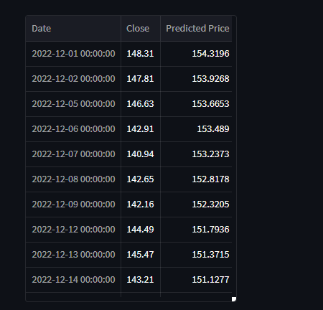
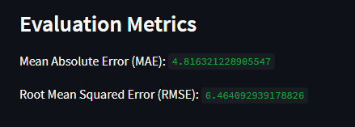
Website images

Slide 17

Video demo

Slide 18
Conclusion:
Stock market forecasts is always been challenging work for business analysts.Thus, Project applies the real time data with neural network to stockpriceforecastandreceives a preferable result, which will provide the research of the stock market development a new thought & We attempted to make use of huge textual data predict stock market indices.
Future enhancement:
In the future work, we will continue to propose more efficient and rapid methods for different stocks in yfincae (yahoo,amazon,,google…) with metrics.to enhance theuserby just clicking the preferred stock and see weather the stock of tomorrow increase or not.

Slide 19
References
Understanding LSTM Networks
http://colah.github.io/posts/2015-08-Understanding- LSTMs/
General Sequence Learning using Recurrent Neural Networks
https://www.youtube.com/watch?v=VINCQghQRuM
Recurrent Neural Networks Part 1: Theory
https://www.slideshare.net/gakhov
Facebook Prophet
https://github.com/facebookincubator/prophet
Images adapted from Shi Yan https://medium.com/@shiyan/understanding-lstm-and-its- diagrams-37e2f46f1714

